Slide 1
Design and Analysis of Algorithms CS345
Lecture 5
Data structures for
Find Rank (contd from last class)
Orthogonal Range Searching
Dynamic sequences

Slide 2
Achieving O(log n) time for FindRank(T,x)
Assume without loss of generality that x belongs to T.
View the entire tree T from perspective of the path from x to the root.
How will T look like ?
x
T

Slide 3
Achieving O(log n) time for FindRank(T,x)
Can you identify the elements that contribute to Rank of x in this picture ?
Elements that are present in the subtrees lying to the left of this path.
And some elements on this path.
x
T

Slide 4
An elegant solution
Fields associated with a node v in T:
Value(v)
Left(v)
right (v)
parent(v)
Keep one more field
Size(v): The number of nodes stored in the subtree rooted at v.

Slide 5
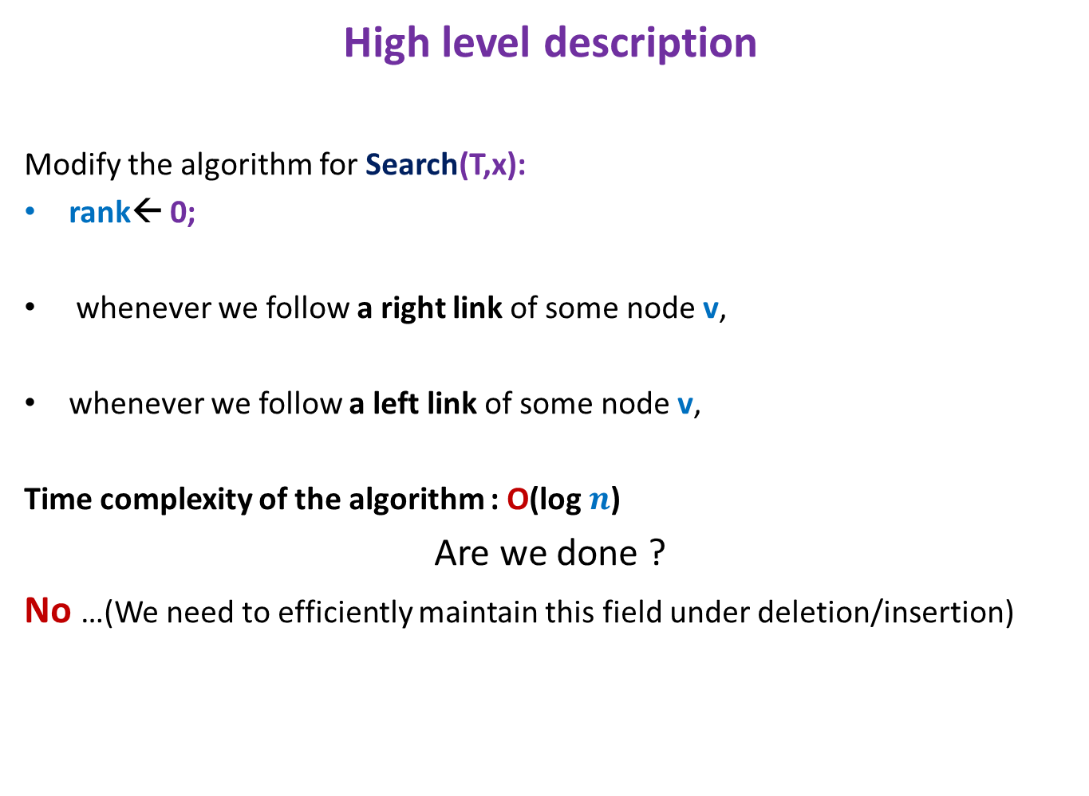
Algorithm for FindRank(T,x)
High level description
Modify the algorithm for Search(T,x):
rank← 0;
whenever we follow a right link of some node v,
whenever we follow a left link of some node v,
Time complexity of the algorithm : O(log $n$)
Are we done ?
No …(We need to efficiently maintain this field under deletion/insertion)
rank← rank + size(left(v)) + 1
Do nothing

Slide 6
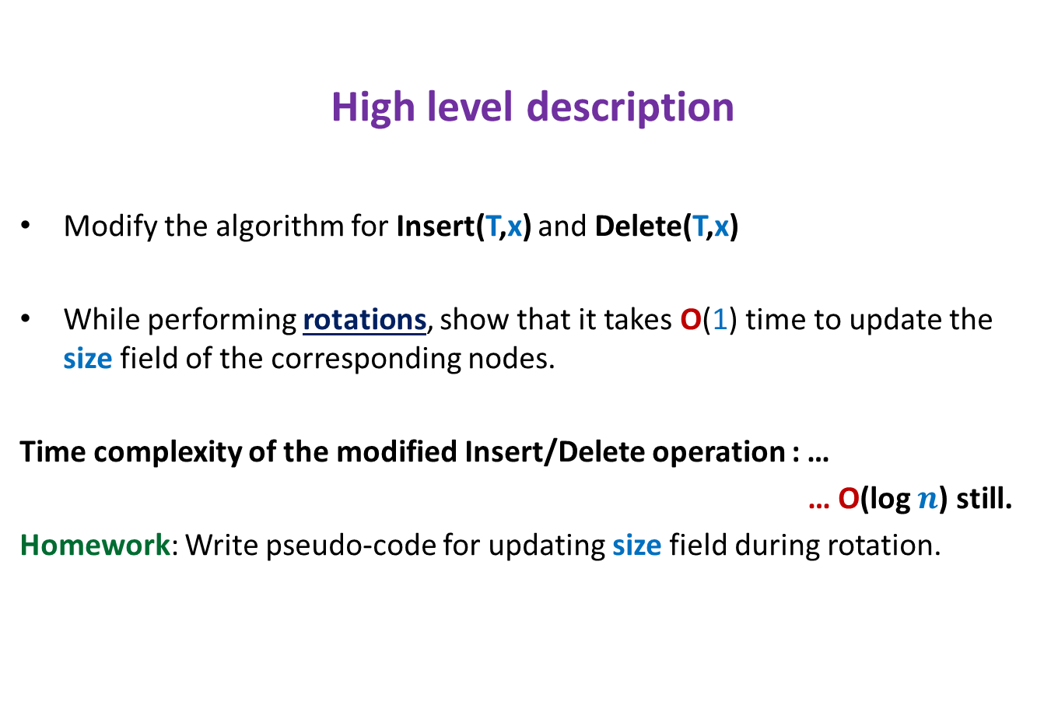
Maintaining size field T under insertion/deletion
High level description
Modify the algorithm for Insert(T,x) and Delete(T,x)
While performing rotations, show that it takes O(1) time to update the size field of the corresponding nodes.
Time complexity of the modified Insert/Delete operation : …
… O(log $n$) still.
Homework: Write pseudo-code for updating size field during rotation.

Slide 7
Hopefully you would have understood the idea of augmentING A BST by now.
So Let us visit a very interesting problem
that employs this powerful technique.

Slide 8





Orthogonal Range searching
RangeSearch(T, $x_{1}$, $x_{2}$, $y_{1}$, $y_{2}$):
Report all points in the rectangle defined by ($x_{1}$, $x_{2}$, $y_{1}$, $y_{2}$)
$$y_{2}$$
$$y_{1}$$
Rectangle
$$x_{1}$$
$$x_{2}$$

Slide 9
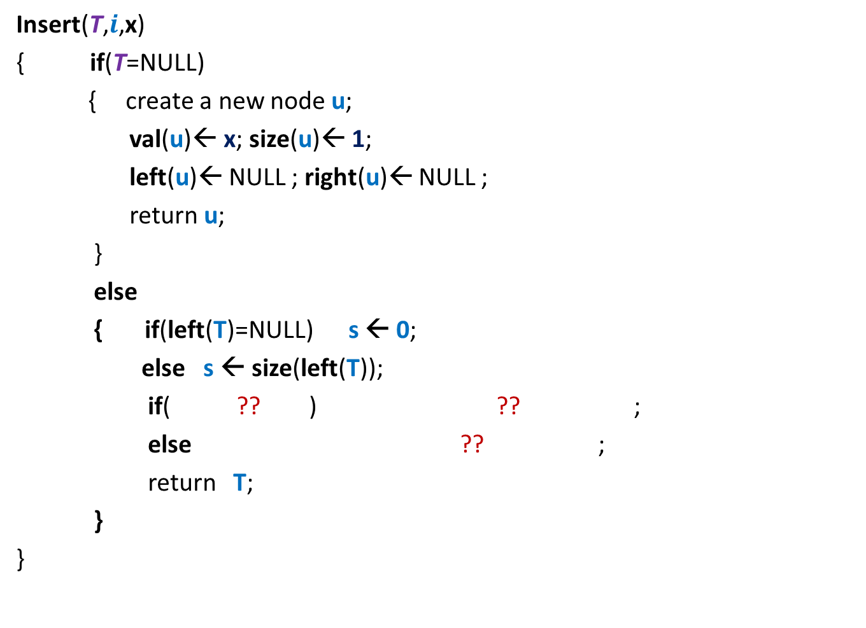
Orthogonal Range searching
Data structure: Size = O($n log n$),
Query = O($k+ \log^{2} n$),
Preprocessing time = O($n log n$)
Rectangle
No. of points in query rectangle

Slide 10
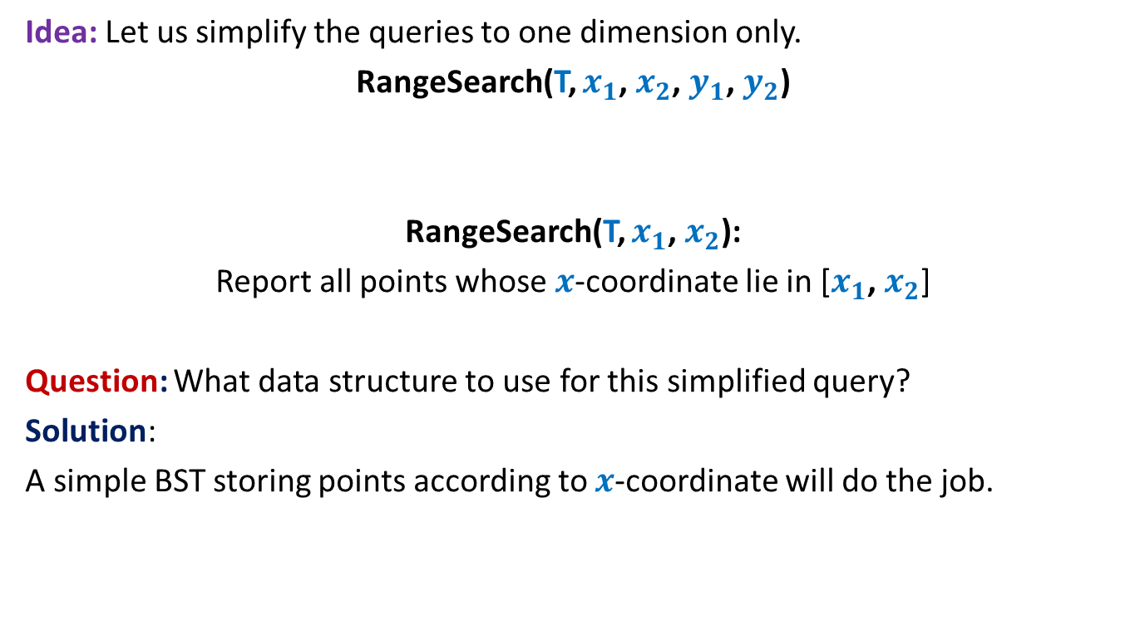
Orthogonal Range searching
Idea: Let us simplify the queries to one dimension only.
RangeSearch(T, $x_{1}$, $x_{2}$, $y_{1}$, $y_{2}$)
RangeSearch(T, $x_{1}$, $x_{2}$):
Report all points whose $x$-coordinate lie in [$x_{1}$, $x_{2}$]
Question: What data structure to use for this simplified query?
Solution:
A simple BST storing points according to $x$-coordinate will do the job.

Slide 11





RangeSearch(T, $x_{1}$, $x_{2}$):
Binary search tree on $x$-coordinates
View the entire tree T from perspective of the paths from $x_{1}$ and $x_{2}$ to the root.
How will T look like ?
LCA
$x_{2}$
$x_{1}$
T

Slide 12
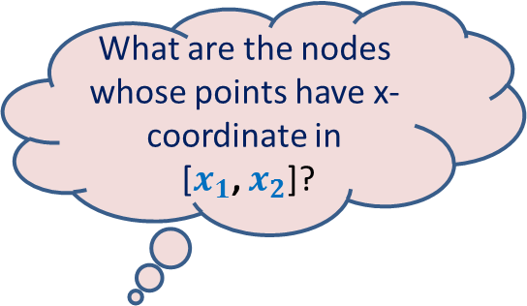

RangeSearch(T, $x_{1}$, $x_{2}$):
Binary search tree on x-coordinates
What are the nodes whose points have x-coordinate in
[$x_{1}$, $x_{2}$]?
LCA
$x_{2}$
$x_{1}$
T

Slide 13
RangeSearch(T, $x_{1}$, $x_{2}$):
Binary search tree on x-coordinates
LCA
$x_{2}$
$x_{1}$
T

Slide 14
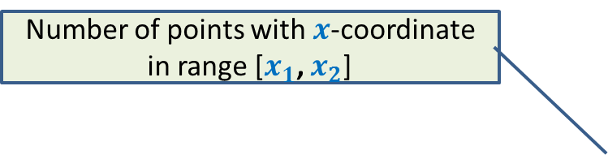

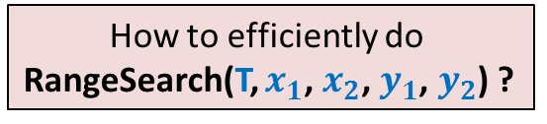
RangeSearch(T, $x_{1}$, $x_{2}$):
Number of points with $x$-coordinate in range [$x_{1}$, $x_{2}$]
Binary search tree on x-coordinates
How to efficiently do
RangeSearch(T, $x_{1}$, $x_{2}$, $y_{1}$, $y_{2}$) ?
Query time = O($k+log n$),
LCA
$x_{2}$
$x_{1}$
T

Slide 15
How should we augment each node?
Augment each node v with a pointer to another BST storing all points of T(v) according to y-coordinates.
value
Color-bit
Y-tree
left
v
right
BST storing T(v) according to y-coordinate
T(v)
v

Slide 16

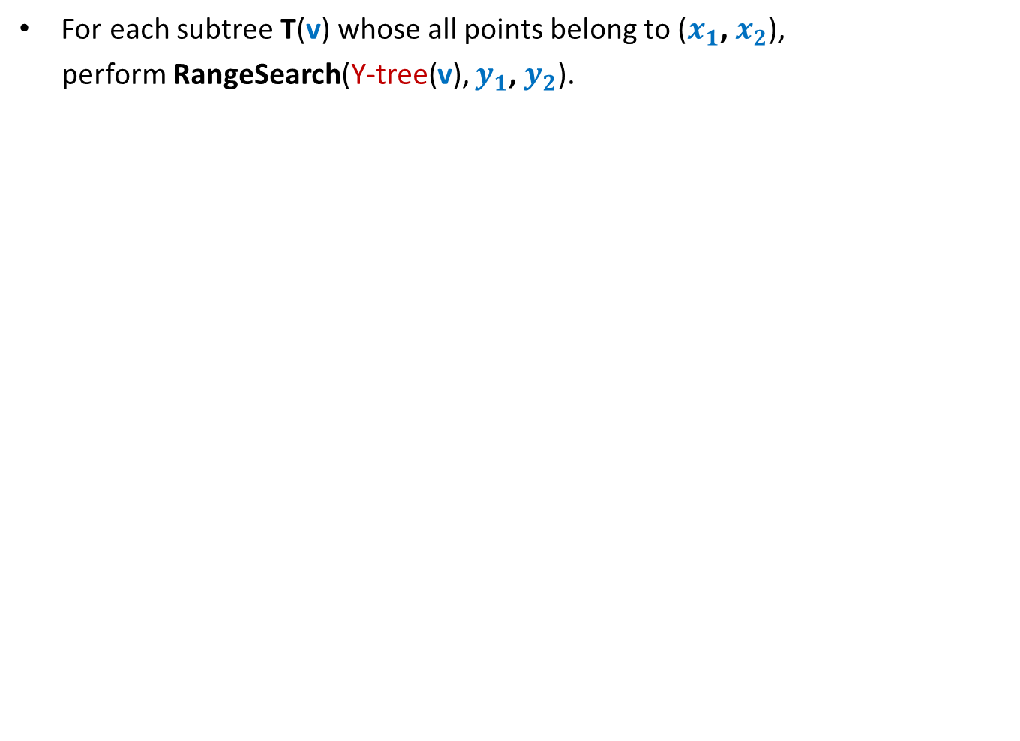

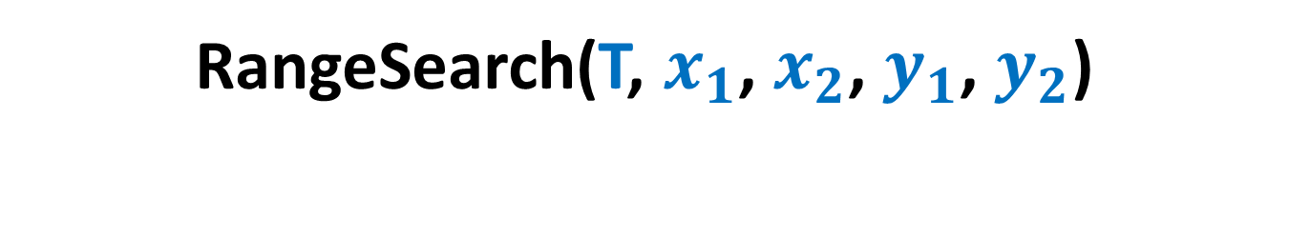
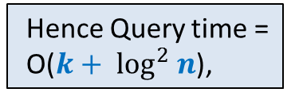
RangeSearch(T, $x_{1}$, $x_{2}$, $y_{1}$, $y_{2}$)
For each subtree T(v) whose all points belong to ($x_{1}$, $x_{2}$),
perform RangeSearch(Y-tree(v), $y_{1}$, $y_{2}$).
For each such subtree, time complexity will be O($k′+log n$), where $k′$are the points present in that subtree that belong to rectangle($x_{1}$, $x_{2}$, $y_{1}$, $y_{2}$).
LCA
There are O($log n$) such subtrees.
Hence Query time =
O($k+ \log^{2} n$),
$x_{2}$
$x_{1}$
T

Slide 17



Space of the data structure
Consider all the nodes at level $i$.
1
2
3
4
. . .
. . .
$$i$$
. . .
. . .
T
O(Log $n$)
BST before augmentation

Slide 18














Space of the data structure
$n_{1}$+ $n_{2}+$ $n_{3}$ + …+ $n_{j}$ < $n$
Total space due to the y-trees at level $i$ :
= $n_{1}$+ $n_{2}+$ $n_{3}$ + …+ $n_{j}$
= O($n$).
$$1$$
$$2$$
$$3$$
. . .
$$j$$
$$i$$
$$n_{1}$$
$$n_{2}$$
$$n_{3}$$
$$n_{j}$$
Total Space = O($n log n$),
. . .
$$n_{1}$$
$$n_{2}$$
T
$$n_{3}$$
$$n_{j}$$
BST before augmentation

Slide 19
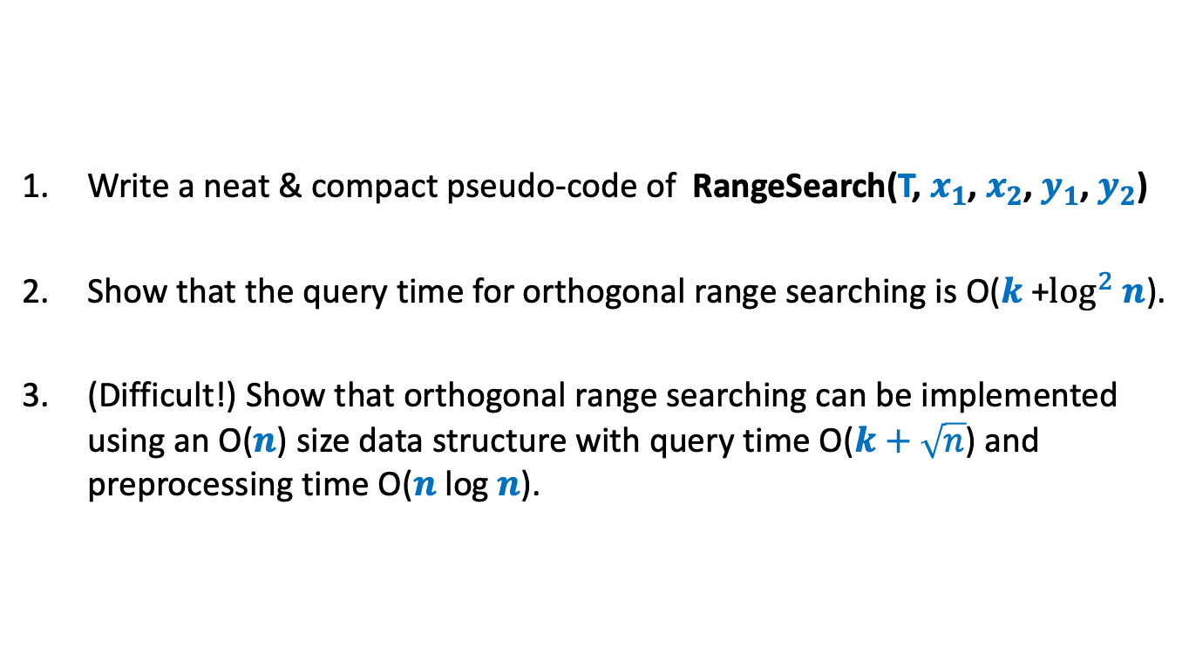
Homework
Write a neat & compact pseudo-code of RangeSearch(T, $x_{1}$, $x_{2}$, $y_{1}$, $y_{2}$)
Show that the query time for orthogonal range searching is O($k$+$\log^{2} n$).
(Difficult!) Show that orthogonal range searching can be implemented using an O($n$) size data structure with query time O($k+\sqrt{n}$) and preprocessing time O($n$log $n$).

Slide 20
Data Structure
For Dynamic Sequences

Slide 21



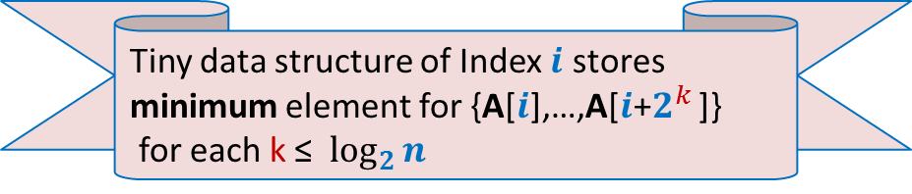

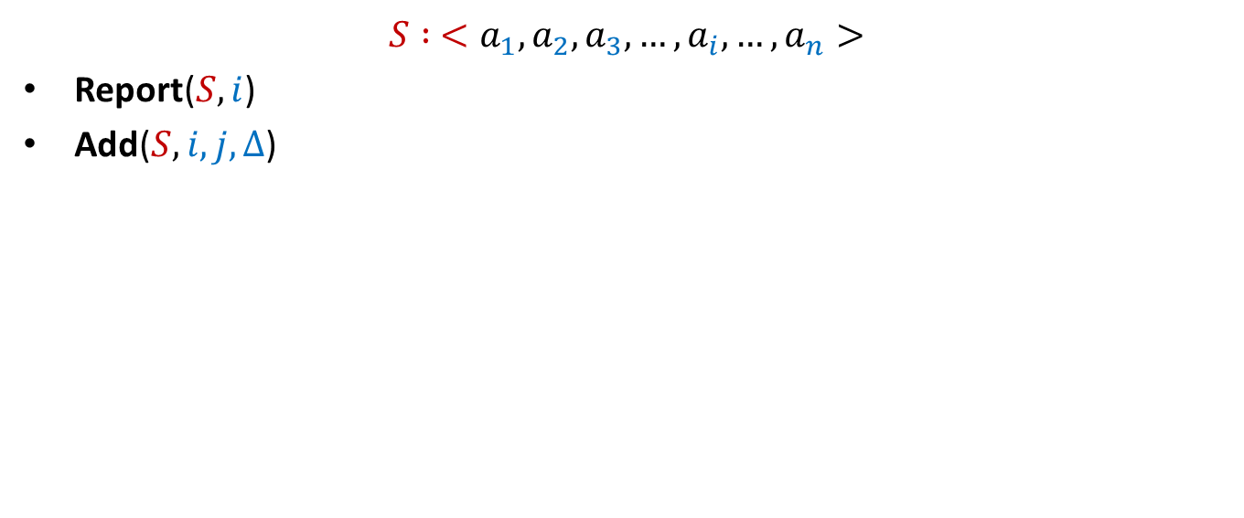




Dynamic Sequences
$$S : <a_{1}, a_{2},a_{3},…,a_{i}, …,a_{n}>$$
Report($S,i$)
Add($S,i,j,Δ$)
Add($S,3,8,6$)
Report($S,5$)
$$S$$
$$5$$
$$3$$
$$1$$
$$701$$
$$23$$
$$19$$
$$41$$
$$83$$
$$8$$
$$5$$

Slide 22




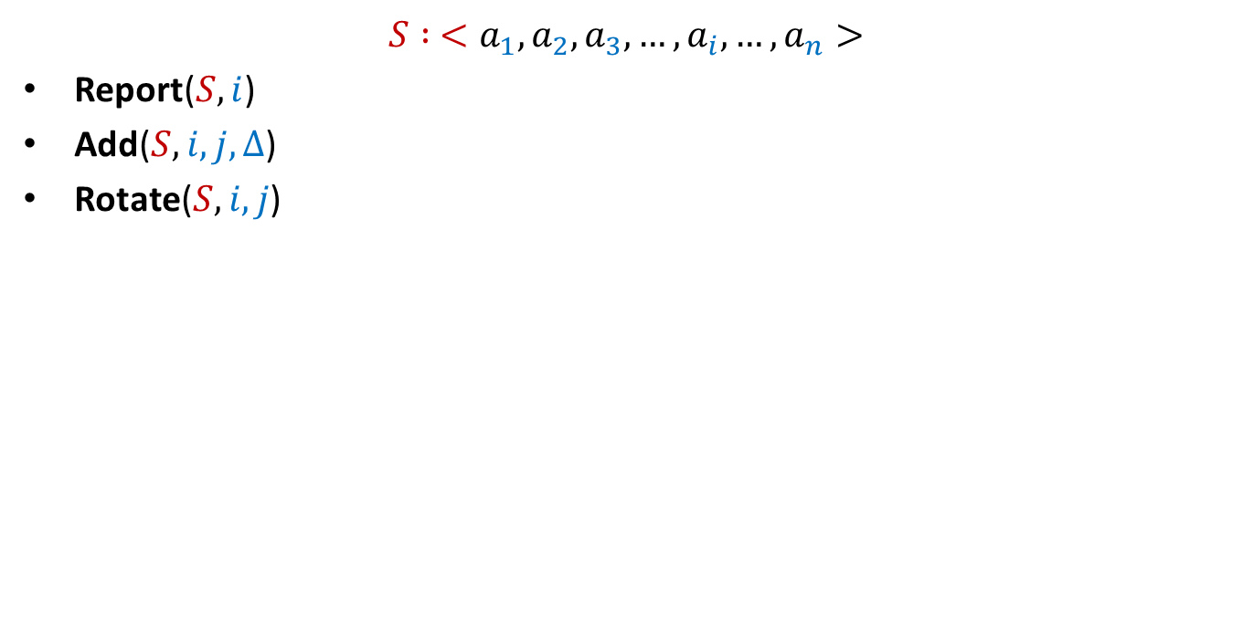


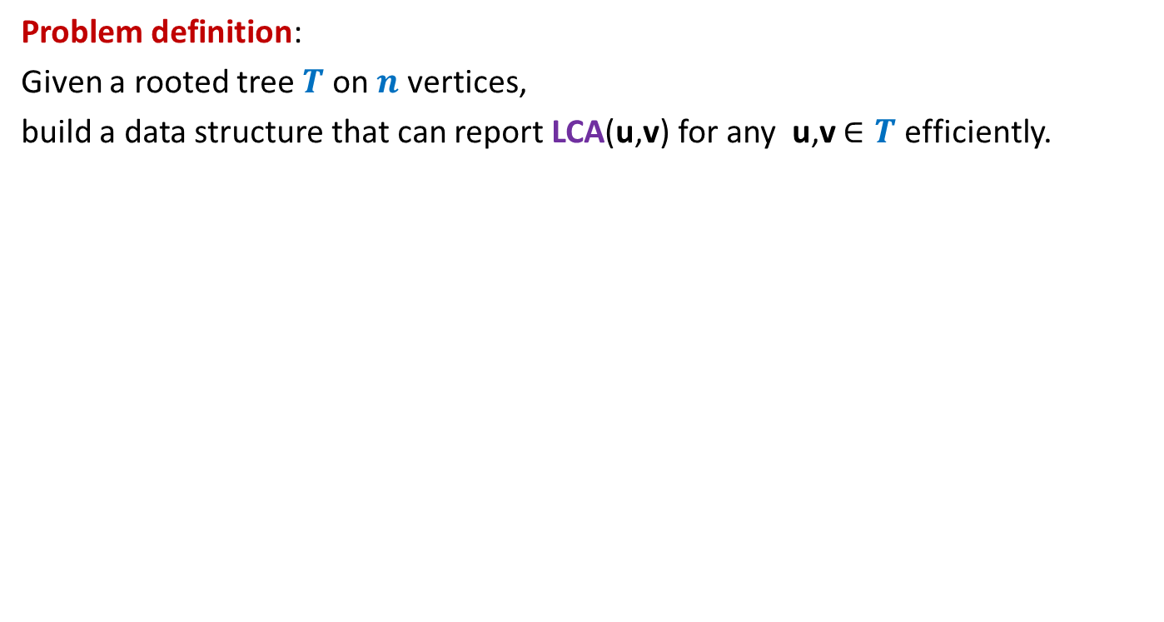






Dynamic Sequences
$$S : <a_{1}, a_{2},a_{3},…,a_{i}, …,a_{n}>$$
Report($S,i$)
Add($S,i,j,Δ$)
Rotate($S,i,j$)
$≈$ log $n$
Rotate($S,4,8$)
$$S$$
$$5$$
$$89$$
$$707$$
$$3$$
$$68$$
$$7$$
$$707$$
$$29$$
$$89$$
$$47$$
$$25$$
$$25$$
$$47$$
$$29$$
$$8$$
$$5$$

Slide 23
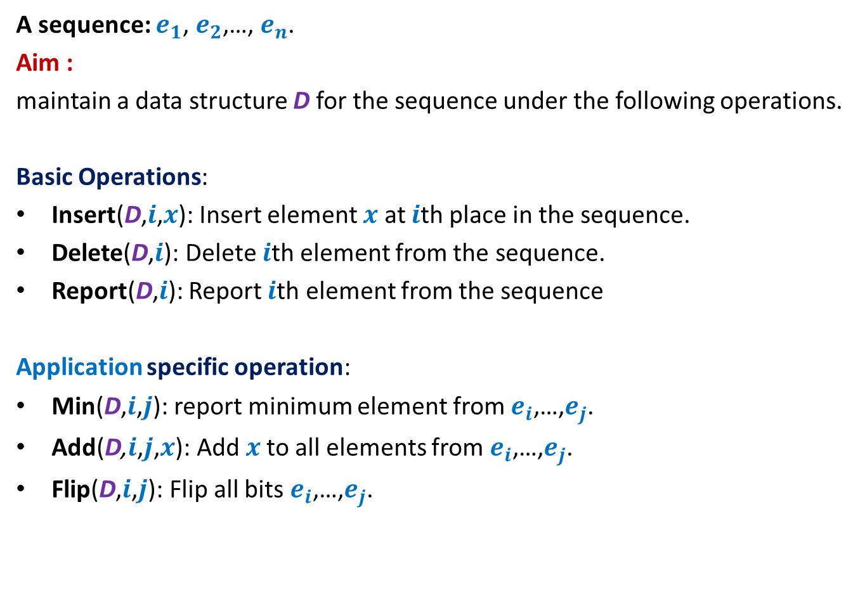
Dynamic Sequence
A sequence: $e_{1}$, $e_{2}$,…, $e_{n}$.
Aim :
maintain a data structure D for the sequence under the following operations.
Basic Operations:
Insert(D,$i$,$x$): Insert element $x$ at $i$th place in the sequence.
Delete(D,$i$): Delete $i$th element from the sequence.
Report(D,$i$): Report $i$th element from the sequence
Application specific operation:
Min(D,$i$,$j$): report minimum element from $e_{i}$,…,$e_{j}$.
Add(D,$i$,$j$,$x$): Add $x$to all elements from $e_{i}$,…,$e_{j}$.
Flip(D,$i$,$j$): Flip all bits $e_{i}$,…,$e_{j}$.
OR
OR

Slide 24



Representing sequence using a BST
A sequence: $e_{1}$, $e_{2}$,…, $e_{n}$.
Example: $6$, $0$, $5$, $13$, $2$, $14$, $1$, $32$.
“Inorder traversal produces the sequence.”
How can we represent a sequence using BST ?
$$2$$
$$0$$
$$1$$
$$6$$
$$5$$
$$14$$
$$32$$
$$13$$

